Slide 1

Elasticsearch: A Game Changer
Guillaume Delporte, Aly Abdelaleem, Jordi Hoorelbeke
24/05/2023
Notes:
Introduce the team members.

Slide 2
Objective
Gain a comprehensive understanding of Elasticsearch, including its advanced capabilities, and discover how leading companies leverage its powerful features for various applications.
24/05/2023
Notes:
Before continuing to the next slide, say what the audience will have learned by the end of the lecture:
They will know what Elasticsearch and the Elastic Stack are.
They will understand the architecture of Elasticsearch and how some big companies use it to their advantage.
They will see some of the many advanced capabilities of Elasticsearch.

Slide 3
What We Cover.
An Introduction to Elasticsearch.
Deep Dive into Elasticsearch's Architecture.
Elasticsearch in Action: How Companies Utilize It.
Advanced Search Techniques with Elasticsearch.
Kibana and Elasticsearch: The Perfect Combination.
Conclusion: Key Takeaways on Elasticsearch.
Notes:
Enumerate the subjects we’ll cover by telling who will be the speaker for each part.

Slide 4
What We Cover.
An Introduction to Elasticsearch.
Deep Dive into Elasticsearch's Architecture.
Elasticsearch in Action: How Companies Utilize It.
Advanced Search Techniques with Elasticsearch.
Kibana and Elasticsearch: The Perfect Combination.
Conclusion: Key Takeaways on Elasticsearch.

Slide 5

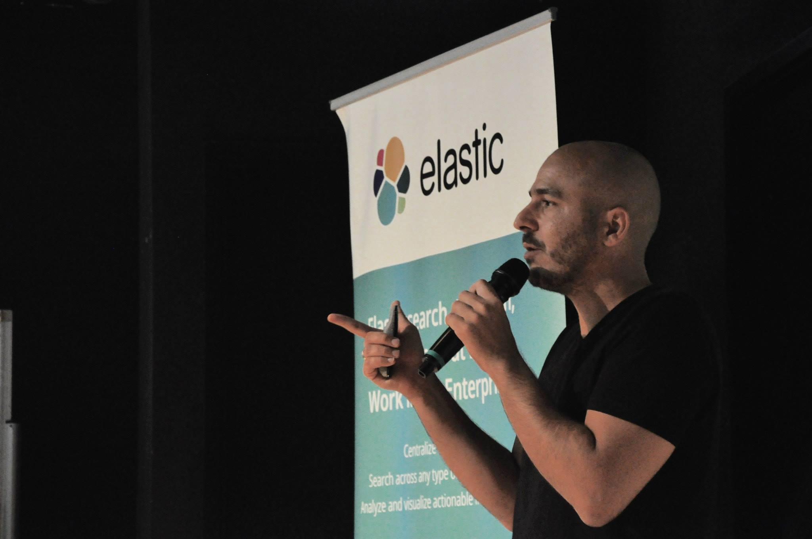
An Introduction to Elasticsearch.
What is ?
Elasticsearch: Distributed, Open-Source search, and analytics engine.
Handles various types of data: textual, numerical, structured, unstructured.
Designed for scalability and can search and index diverse document formats.
Created by Shay Banon between 2004-2009
Shay Banon, Elasticsearch’s creator

Slide 6

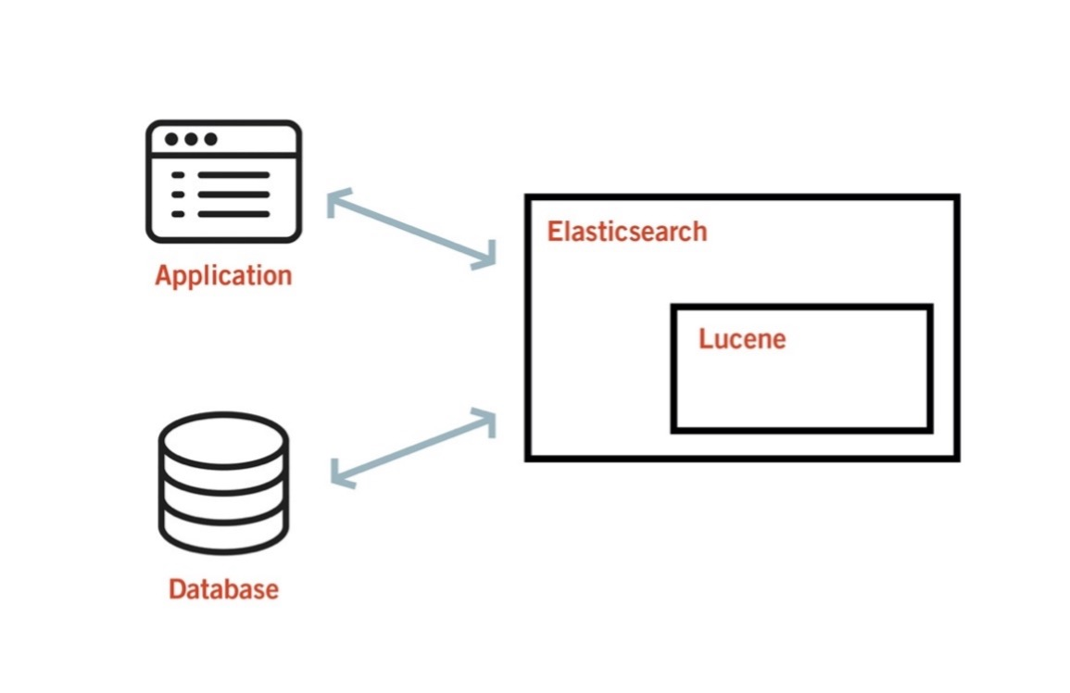

and
Based on Apache Lucene.
Lucene: Free and open-source information retrieval software library.
Lucene developed by Doug Cutting.
Elasticsearch leverages Lucene's capabilities for full-text search.
Doug Cutting,
Open-Source software developer
Figure from : https://www.endava.com/en/blog/Engineering/2021/Elasticsearch-and-apache-lucene-fundamentals-behind-the-relevance-score

Slide 7
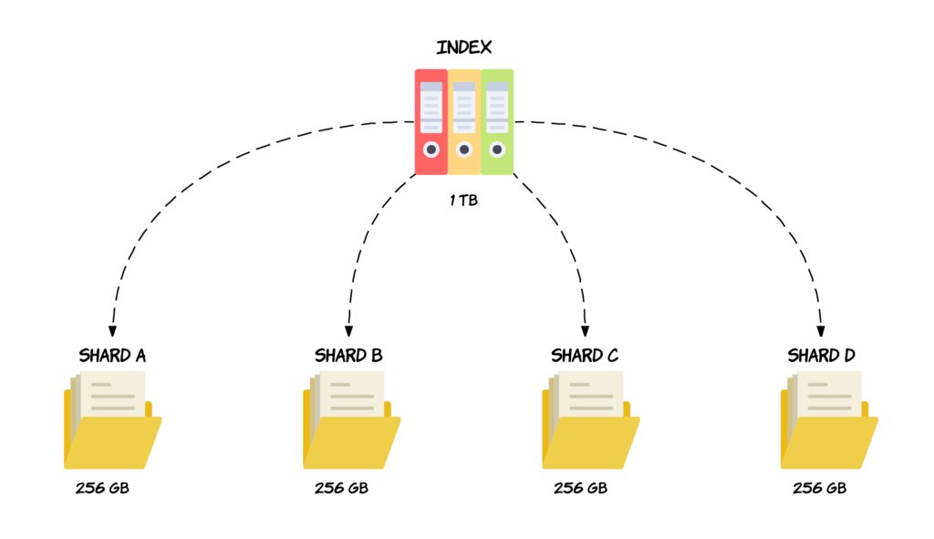
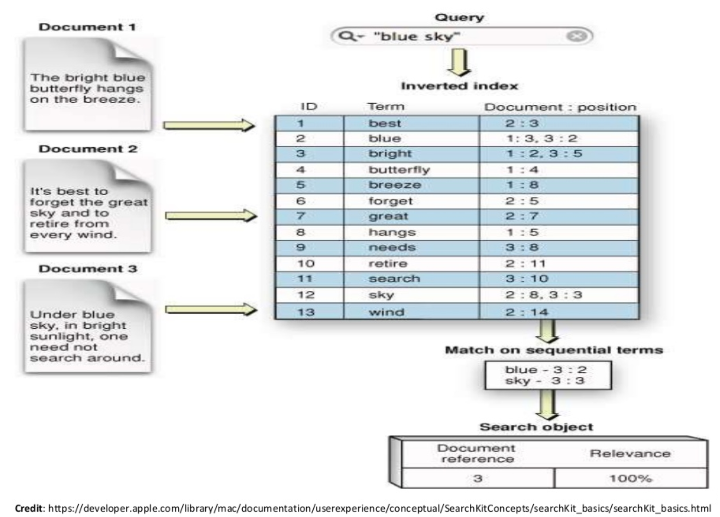
How Does Work?
Data stored as JSON (JavaScript Object Notation).
Document organized in indices, similar as in relational databases.
Indices further divided into shards, distributed across cluster nodes.
Figure from : https://codingexplained.com/coding/elasticsearch/understanding-sharding-in-elasticsearch

Slide 8
Inverted Index for Speed and Flexibility
uses an inverted index for fast search.
Inverted index stores unique words and documents they appear in.
Enables quick lookup and retrieval of search results.

Slide 9

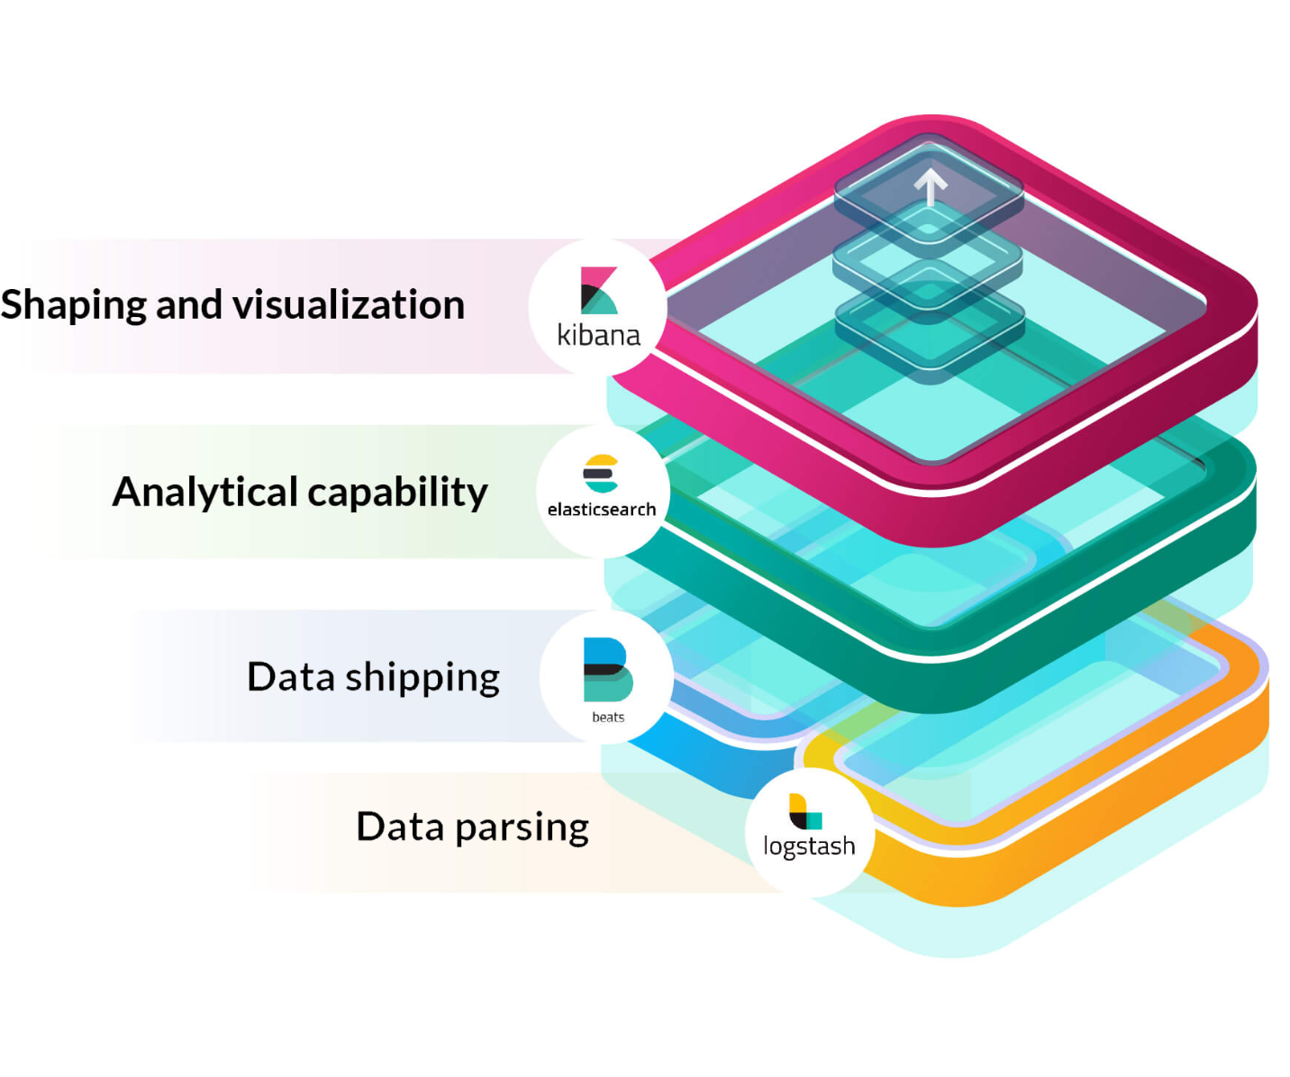
and the Elastic Stack
Elasticsearch is part of the Elastic Stack.
Elastic Stack components: Elasticsearch, Logstash, Kibana, Beats.
Logstash: Data processing pipeline for ingesting and transforming data.
Kibana: Visualization and analysis layer for Elasticsearch data.
Figure from: https://quintagroup.com/services/the-elastic-stack-and-its-components-elasticsearch-kibana-logstash-and-beats

Slide 10
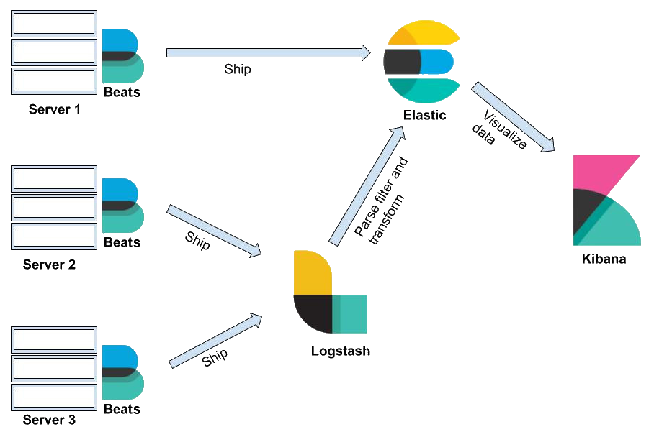
The Elastic Stack (Cont'd.)
Beats: Lightweight data shippers for sending operational data.
Beats can send data directly to Elasticsearch or via Logstash for processing.
The Elastic Stack provides a comprehensive data management and analysis solution.

Slide 11
What We Cover.
An Introduction to Elasticsearch.
Deep Dive into Elasticsearch's Architecture.
Elasticsearch in Action: How Companies Utilize It.
Advanced Search Techniques with Elasticsearch.
Kibana and Elasticsearch: The Perfect Combination.
Conclusion: Key Takeaways on Elasticsearch.

Slide 12
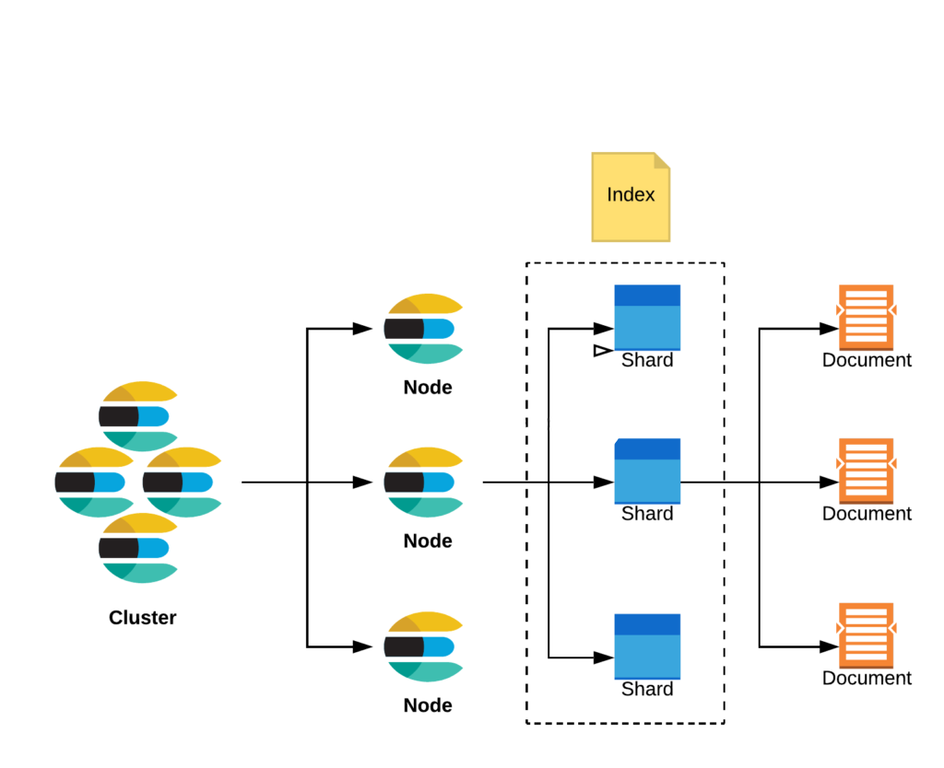
Deep Dive into
Architecture
A cluster contains one or more nodes.
A node is an instance of Elasticsearch
Index is used to group shards that contain related data.
Shard is where data is stored.
Data is stored as documents.

Slide 13
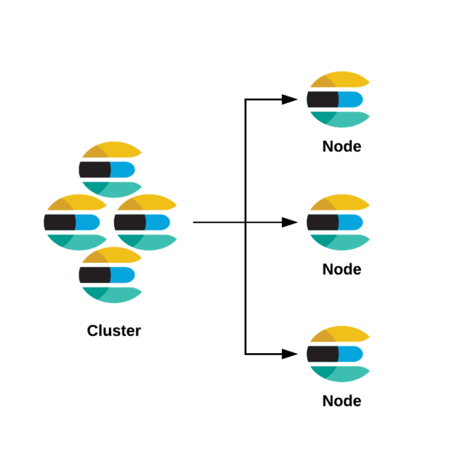
Cluster
A cluster is a collection of nodes that work together to achieve a common goal.
Each cluster has a unique name.
When creating a node, one cluster comes with it by default.
The cluster is managed by a master node.
Notes:
Cluster = Team
Team members = Nodes

Slide 14
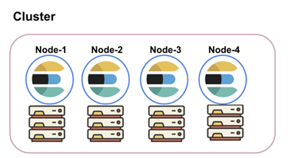
Node
A node is an instance of Elasticsearch with a unique id and a name.
A node must belong to a cluster.
Nodes are recommended to be distributed across several machines, but you can have multiple nodes on one machine.
A node can have multiple roles.
Notes:
Data nodes: These nodes store and manage the data. They handle operations related to indexing, searching, and retrieving documents.
Master-eligible nodes: These nodes participate in the election process to select a master node.
Master node: These nodes are responsible for cluster-wide management tasks such as creating or deleting indices, adding or removing nodes.

Slide 15
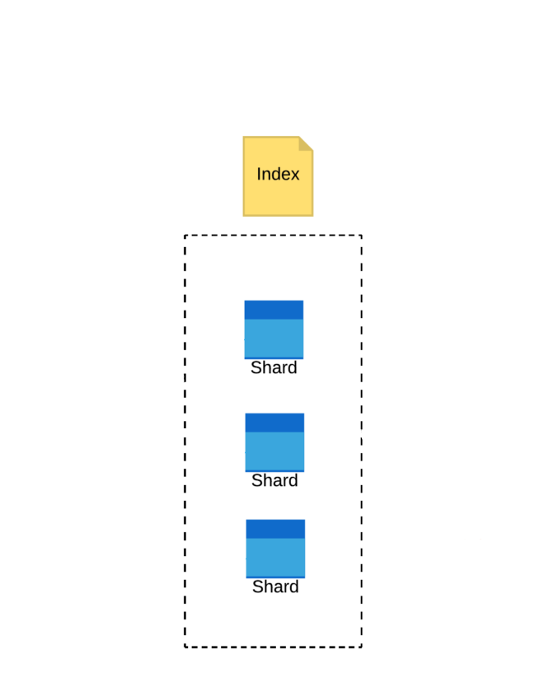
Index
Index is a logical way to group shards that contain documents that are related to each other.
Similar to a database in traditional systems.
When creating an index, one shard comes with it by default.
Index can be configured to allow multiple shards across multiple nodes (Sharding).

Slide 16
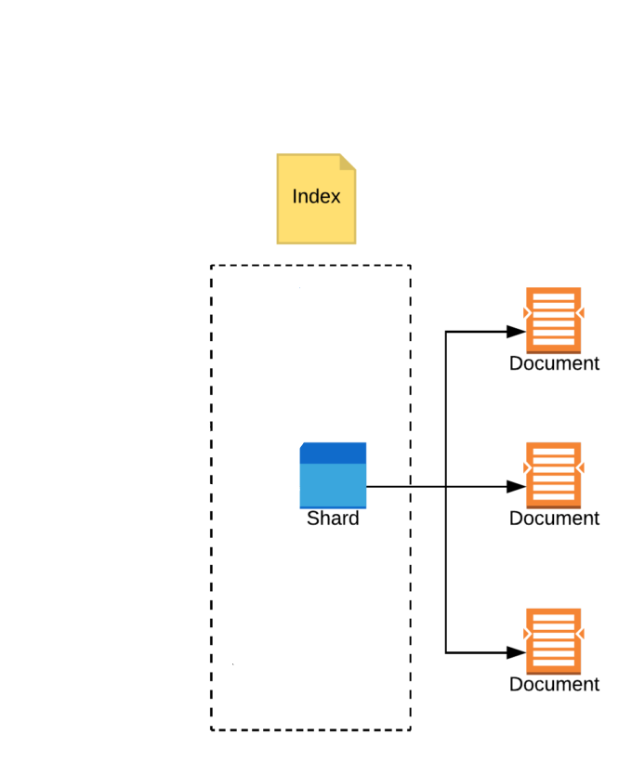
Shard
Shard is actually where data is stored on disk and where searches are run.
A shard can be:
Primary shard
Replica shard
Elasticsearch allows you to configure the number of replica shards per primary shard.
Benefits of sharding: horizontal scaling, parallel queries, backup, and load balancing using replica shards.
Notes:
The primary shard is responsible for handling all write operations for its assigned documents.
A replica shard is an exact copy of a primary shard.

Slide 17
Document
{
"_index": "blog",
"_id": "123456",
"_version": 2,
"_source": {
"title": "Introduction to Elasticsearch",
"author": "John Doe",
"publish_date": "2022-01-15",
"content": "Elasticsearch is a scalable search and analytics engine built on Apache Lucene. It offers real-time search capabilities, making it popular for log analytics, full-text search, and more. Its flexible data model and distributed architecture support powerful querying and analysis."
}
}
Data is stored as documents, which is a JSON object that is stored with a unique id.
Documents are schema flexible.
Documents have version number which are incremented with each update.

Slide 18
What We Cover.
An Introduction to Elasticsearch.
Deep Dive into Elasticsearch's Architecture.
Elasticsearch in Action: How Companies Utilize It.
Advanced Search Techniques with Elasticsearch.
Kibana and Elasticsearch: The Perfect Combination.
Conclusion: Key Takeaways on Elasticsearch.

Slide 19
Elasticsearch in Action: How Companies Utilize It.
Vodafone (EG) used it as a log analytics and reporting tool for their Website and App (personal experience).
eBay's search infrastructure is powered by Elasticsearch help them deliver relevant results.
NASA uses Elasticsearch to analyze and search through large volumes of telemetry data collected from satellites and space missions.
Uber uses Elasticsearch to power real-time geospatial search.
Notes:
eBay: eBay utilizes Elasticsearch for their search infrastructure, allowing users to perform fast and accurate product searches across millions of listings. Elasticsearch helps power their relevance ranking algorithms, filters, and facets to deliver relevant search results to their users.
NASA: NASA uses Elasticsearch to analyze and search through large volumes of telemetry data collected from satellites and space missions. Elasticsearch enables NASA scientists to perform real-time analysis, anomaly detection, and deep dive investigations into the collected data.
Uber leverages Elasticsearch to analyze and search through large volumes of geospatial data. Elasticsearch helps power their real-time geospatial search and routing systems, allowing users to quickly find nearby drivers and estimate arrival times.

Slide 20
What We Cover.
An Introduction to Elasticsearch.
Deep Dive into Elasticsearch's Architecture.
Elasticsearch in Action: How Companies Utilize It.
Advanced Search Techniques with Elasticsearch.
Kibana and Elasticsearch: The Perfect Combination.
Conclusion: Key Takeaways on Elasticsearch.

Slide 21
Advanced Search Techniques with Elasticsearch.
Fuzzy Search
Highlighting
Regexp Searches
Boosting
&
Scoring
Proximity Search
Aggregation Search
And many more…

Slide 22
What We Cover.
An Introduction to Elasticsearch.
Deep Dive into Elasticsearch's Architecture.
Elasticsearch in Action: How Companies Utilize It.
Advanced Search Techniques with Elasticsearch.
Kibana and Elasticsearch: The Perfect Combination.
Conclusion: Key Takeaways on Elasticsearch.

Slide 23
Kibana and Elasticsearch: The Perfect Combination.
Elastic Stack
What is Kibana?
Elastic-
search
Kibana
Visualization capabilities on top of indexed content.
Geospatial analysis tool for creating and layering maps.
Development tools for developers to interact with the Elasticsearch REST API.
Users can create and manage alerts that notify them when real-time data meets certain conditions.
Logstash
Beats

Slide 24
Kibana and Advanced Search: A Demo.

Slide 25
What We Cover.
An Introduction to Elasticsearch.
Deep Dive into Elasticsearch's Architecture.
Elasticsearch in Action: How Companies Utilize It.
Kibana and Elasticsearch: The Perfect Combination.
Advanced Search Techniques with Elasticsearch.
Conclusion: Key Takeaways on Elasticsearch.

Slide 26
Conclusion: Key Takeaways on Elasticsearch
Elasticsearch: A potent, distributed search and analytics engine, underpinned by Apache Lucene.
Distributed Architecture: Ensures high availability and resilience, with a structure composed of nodes, indices, shards, and replicas.
Elastic Stack Synergy: Elasticsearch operates in concert with Kibana, Logstash, and Beats to provide a holistic data analysis solution.

Slide 27
Key Takeaways on Elasticsearch (Cont'd)
Advanced Search: Employs sophisticated techniques such as fuzzy search, proximity matching, boosting, and aggregations for precise and intricate searches.
Customizable Scoring: Allows tailoring of relevance scoring to cater to specific needs.
Versatility: Used for a broad range of applications, including full-text search, data analysis, log, and event data management.
Scalability and Resilience: Its ability to scale and remain resilient makes Elasticsearch a preferred choice among various organizations.

Slide 28
Elasticsearch: Going further
Official Elasticsearch Documentation
Tutorialspoint’s Elasticsearch tutorial Tutorial series created by LisaHJung
Thank you for your attention!

